Slide 1
Unit 1 Graphics Hardware Contd.)

Slide 2
Properties of CRT
• Persistence
How long the phosphor continue to emit light after CRT beam is removed.
• Resolution
Maximum number of points that can be displayed without overlapped is known as resolution. In other words, it is the number of points per centimeter that can be plotted horizontally and vertically.
• Aspect Ratio
Ratio of vertical points to horizontal points necessary to produce equal length of lines in both directions is known as aspect ratio.

Slide 3
Color CRT
• A color CRT monitor displays color pictures by using a combination of phosphors that emit different-colored light.
By combining the emitted light from the different phosphors, a range of colors can be generated.
The two basic techniques for producing color displays with a CRT are;
1. Beam Penetration Method
2. Shadow Mask Method

Slide 4
1. Beam Penetration Method
It is a cheaper method and is used in Vector scan displays. In this method the inside section of CRT is coated with red (outer layer) and green (inner layer) phosphors.
If the electrons are slow they penetrate only the outer layer thus emitting red light, and if the electrons are moving fast they penetrate the outer layer and the inner layer.
The electrons speed is also adjusted in such a way that by combination of red and green, orange and yellow color are also produced.

Slide 5
2. Shadow Mask Method
A shadow Mask CRT has three phosphor color dots at each pixel location.
One phosphor dot emits a red light, another emits green light and the last one emits a blue light.
This type of CRT also has three electron guns one for each color dot. A shadow mask grid is installed just behind the phosphor coated screen.
The three electron beams are deflected and focused as a group onto the shadow mask, which contains a series of very fine holes aligned with the phosphor dot patterns
When the three beams pass through a hole in the shadow mask, they activate a dot triangle, which appears as a small color spot on the screen.
The color of pixel is controlled by light of intensity. Different colors can be obtained by varying the intensity levels

Slide 6
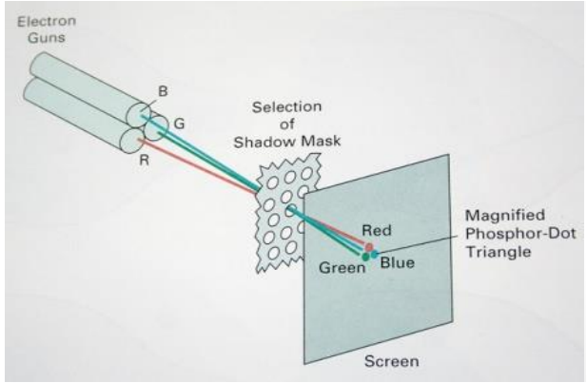
Fig: Shadow Mask Method

Slide 7
Display Technologies
Raster-Scan Displays
2. Random-Scan Displays

Slide 8
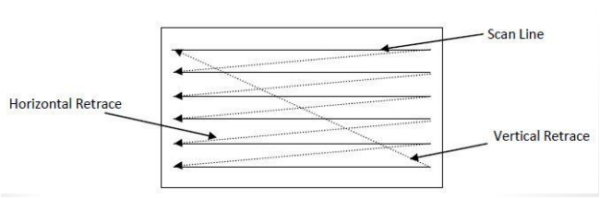
Raster Scan Display
The most common type of graphics monitor employing a CRT is the raster-scan display.
In raster scan approach, the viewing screen is divided into a large number of discrete phosphor picture elements, called pixels.
Row of pixels is called the scan line. The matrix of pixels or collection of scan lines constitutes the raster (shown in figure below).

Slide 9
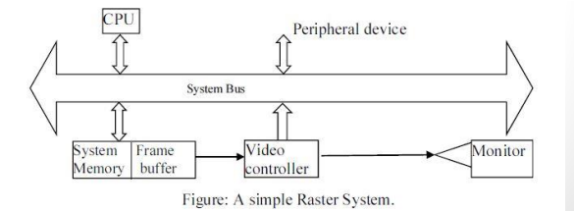
Architecture of Raster Scan
The raster graphics systems typically consists of several processing units.
CPU is the main processing unit of computer systems. Besides CPU, graphics system consists of a special purpose processor called video controller or display processor.
The display processor controls the operation of the display device.
A fixed area of system memory is reserved for the frame buffer. The video controller has the direct access to the frame buffer for refreshing the screen.

Slide 10
Random (Vector) Scan Display
• In a random scan display unit, electron beam directed towards only to the parts of the screen where a picture is to be drawn.
• Random-scan monitors draw a picture one line at a time and for this reason are also referred to as vector displays (or stroke-writing or calligraphic displays).
Random scan system uses an electron beam which operates like a pencil to create a line image on the CRT. The component line can be drawn or refreshed by a random scan display system in any specified order

Slide 11
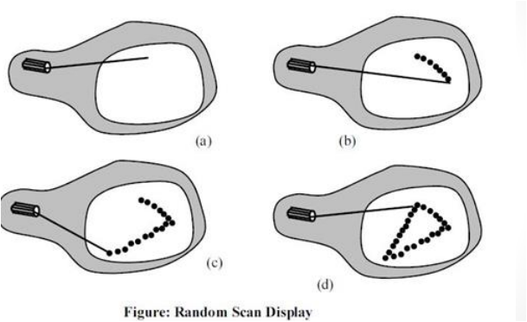
Random Scan Display

Slide 12
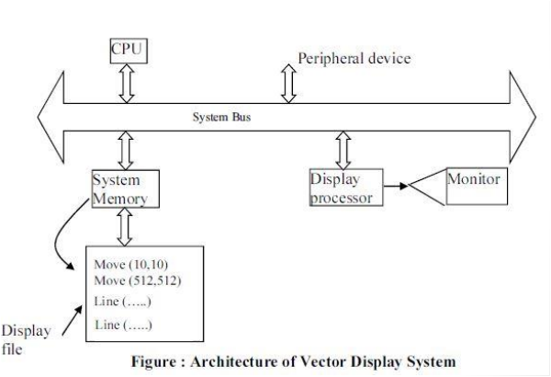
Vector or Random Scan Display processor

Slide 13
Architecture of Random Scan Display
Vector display system consists of several units along with peripheral devices. The display processor is also called as graphics controller.
• Graphics package creates a display list and stores in systems memory (consists of points and line drawing commands) called display list or display file.
• Refresh time around 50 cycles per second.
• Vector display technology is used in monochromatic or beam penetration color CRT.
• Graphics are drawn on a vector display system by directing the electron beam along component line.

Slide 14
Flat Panel Display(FPD)
They are far lighter and thinner than traditional cathode ray tube (CRT) television sets and video displays and are usually less than 10 centimeters (3.9 in) thick.
• Sometimes abbreviated as FPD, a flat-panel display is a thin screen display found on all portable computers and is the new standard for desktop computers.
Unlike (CRT) monitors, flat panel displays use liquid-crystal display (LCD) or light-emitting diode (LED) technology to make them much lighter and thinner compared to a traditional monitor.
Types
1. LED (light-emitting diode)
2. LCD (liquid-crystal display)

Slide 15
2. Liquid Crystal Display (LCD):
LCDs are commonly used in small system such as calculator, portable laptop, computer,etc.
Liquid crystals are almost transparent substances exhibiting the properties of both liquid and solid.
Light passing through liquid crystals follow the alignment of the molecules that make up a property of solid matter. In LCDs, Liquid crystals are sandwiched between thin polarized sheets.
They consume 1/3rd of the power of CRT and also emits lesser radiation than CRTs.
The drawback of LCD monitor is that he viewing angle is only 160 degree so, we may not view the monitor from sides.

Slide 16
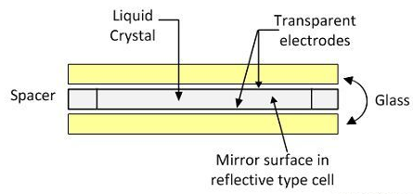
Advantages: Good color reproduction Very thin Light weight Excellent longevity (life span)
Disadvantages: Fixed resolution Poor constraint ratios Viewing angle on older models may be
narrow(160 degree)

Slide 17
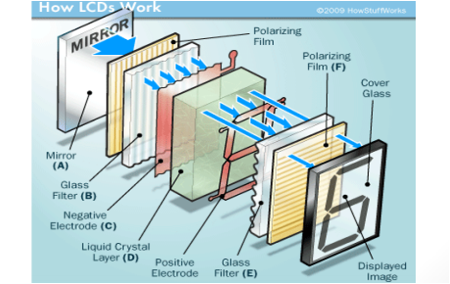
How LCD work
• The pixels are controlled in completely different ways in plasma and LCD screens.
In a plasma screen, each pixel is a tiny fluorescent lamp switched on or off electronically.
In an LCD television, the pixels are switched on or off electronically using liquid crystals to rotate polarized light

Slide 18
Light Emitting Diodes
Light Emitting Diodes (LED):
Matrix of diode is arranged to form a pixel position in the display.
LED emits light, when electrons from n-region and holes from p-region are moved to a p-n junction.
LEDs are employed in a wide verity of applications including optical display devices, traffic lights, communication devices, etc.
Organic light emitting diodes are promising technology for flat panel display.
Organic light emitting diodes are useful in wide range and low resolution display devices
OLED’s are emissive displays that provides an alternative to other types of light emisstion having fluorescence devices.

Slide 19
Advantages: Great efficiency Lamp life is 100000 hours Became cost effective when the price of semi-conductors fell Disadvantages: Need a lot of LED's to produce light.
Consistency of led is an issue New technology still relatively expensive

Slide 20
Q1. Consider a raster system with resolution of 640x 480, What is the size of frame buffer (in bytes) is needed for the system to store 12 bits/pixel ?
Ans: Total no. of pixel required: (640 x 480) pixels
Size of the frame buffer required = (640x480) pixels.
Also 1 pixel can store 12 bits (given)
Therefore, size of frame buffer (in bits) is,
= 640x 480x 12 bits
= (640 x 480 x12)/8 bytes
= 460800 bytes
= 450 KB

Slide 21
Q.N.1.: If the pixel values are accessed from the frame buffer with an average access time (for one single pixel) of 20 ns and the total resolution of the screen is 1024 X 800 , will there be a flickering effect seen on the screen ? Ans:
To glow one single pixel takes = 20 ns To glow all pixel on screen it takes = 1024 X 800 X 20ns = 16,384,000ns = 0.01638 second Now frequency(F) = 1/T = 1/0.01638 = 61.05 HZ since it is above 50times/sec there will be no flickering effect seen on screen

Slide 22
Q.N.2:. In case of raster system with resolution 1024 X 1280, how many pixel could be accessed per second in the system by a display controller at a rate of 60 frames per second? what is accessed time per pixel in this system ?
Ans : 1. Pixel accessed : = 1024 X 1280 X 60 pixel can be accessed in this system 2. Access time per pixel: = 1/(1024 X 1280 X 60 ) = 12.71ns

Slide 23
Q4. How much time is spent scanning across each row of pixels during screen refresh on a raster system with a resolution of 1280 by 1024b and a refresh rate of 60 frames per second ?

Slide 24
Resolution=1280*1024
Refresh Rate= 60 frames per second
Since 1 frame consist 1024 scan line
Also 60 frames takes 1 sec for refreshing
1 frame takes 1/60 sec.
1024 scan lines = (1/60) *1024 sec
= 0.058 sec
= 58 ns.

